Slide 1



In-Depth Social Impact Measurement & Management Online Training
Live Session, Module 4, 2 december 2021, 09:00-12:00 CET

Slide 2
Understanding the BSO’s perspective on IMM. The practical experience of two EVPA members

Slide 3




ADAM RICHARDS
DIRECTOR OF IMPACT, SVI
SOCIAL VALUE INTL
SARA SEGANTI
SENIOR TRAINING MANAGER
EVPA
FLORIAN TUDER
TRAINING ACADEMY COORDINATOR
EVPA
ANDREA RESTA
TRAINING ACADEMY INTERN
EVPA

Slide 4
Module 4 | The practical experience of two EVPA members: best practices in IMM from the funders’ perspective
E-learning phase On Zoom: Module 4 Live Session 2 December 2021 09-12am CET Speakers and facilitators: Sofia Shaginyan, Navstrechu Peremenam Maya Volwahsen, Respond Accelerator, BMW Foundation Adam Richards, Social Value UK Sara Seganti, EVPA Florian Tuder, EVPA | Preparation for the live session and assessment of comprehension Reflections on measuring and managing impact from the funders’ perspective Examples from practice – two investors for impact will showcase how to measure and manage impact. Sofia Shaginyan, Navstrechu Peremenam Maya Volwahsen, Respond Accelerator - BMW Foundation Conclusions, Q&A, and wrap-up

Slide 5
Discussing the BSO’s Perspective to Impact Measurement & Management
SARA SEGANTI, EVPA
Notes:
TIMING: 10.00-10.20

Slide 6
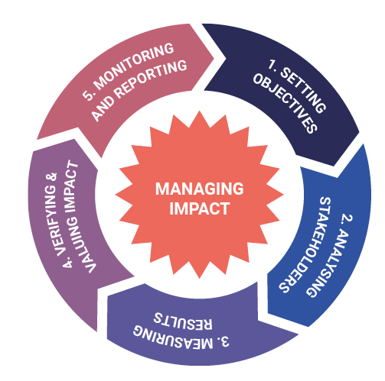
IMPACT MANAGEMENT SYSTEM AT THE INVESTOR LEVEL
1. IMPACT OBJECTIVES?
5. HOW TO MONITOR AND REPORT AT THE INVESTOR LEVEL?
Set at the investor level & relationship with investee/SPO.
Collect & analyse data to
measure & report on the investor’s progress, the NFS provided and the investees’ impact.
2. WHICH STAKEHOLDERS?
At the investor level: the investees (direct) and the final beneficiaries (indirect)
4. HOW TO VERIFY AND VALUE THE VP/SI IMPACT?
NFS provided to the SPO and final impact on final beneficiaries if measurable.
3. HOW TO MEASURE RESULTS AT THE INVESTOR LEVEL?
Considering both IM at portfolio level and the impact of the investor on the investee and on the final beneficiaries.
Notes:
1. IMPACT OBJECTIVES?
Set at the investor level & relationship with investee/SPO.
Best practice would be to consider the impact value chain at both levels.
2. WHICH STAKEHOLDERS
At the investor level: the investees (direct) and the final beneficiaries of the SPOs (indirect)
3. HOW TO MEASURE RESULTS AT THE INVESTOR LEVEL?
Considering both IM at portfolio level and the impact of the work of the investor on the SPO.
Analysing data to identify problems and implementing corrective actions at the investment strategy level.
4. HOW TO VERIFY AND VALUE THE VPO IMPACT?
NFS provided to the SPO and final impact on final beneficiaries if measurable.
5. HOW TO MONITOR AND REPORT AT THE INVESTOR LEVEL?
At the investor level, collect and analyse data to measure and report on the investor’s progress, the NFS provided and the investees’ impact (potentially).

Slide 7
TWO LEVELS OF IMPACT FOR THE FUNDER
Investor/Business Support Organisation
ToC
Investment Strategy
SPO
ToC
Business plan
BENEFICIARIES
DIRECT IMPACT
INDIRECT IMPACT
DIRECT IMPACT
Notes:
EVPA
The two levels of impact the VPO has

Slide 8
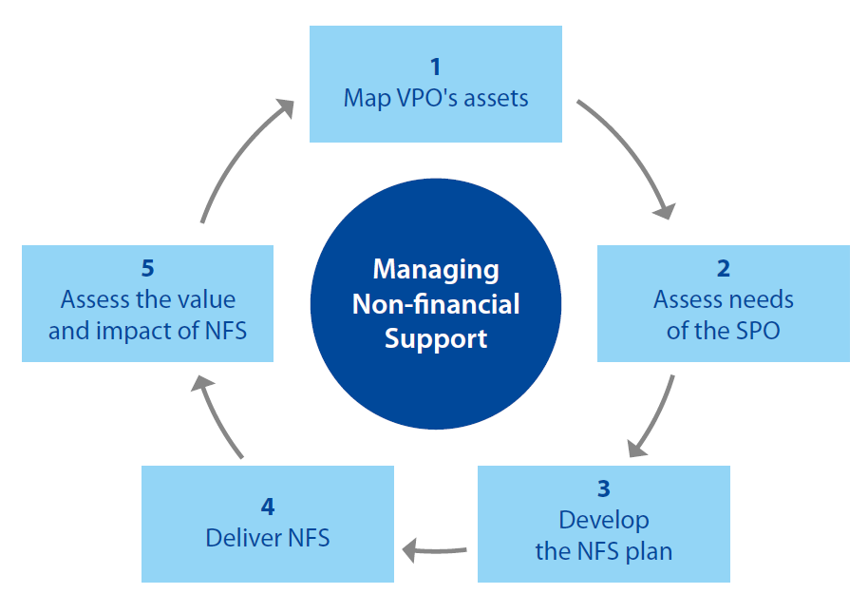
DIRECT IMPACT: THE EVPA FIVE-STEPS ON NON FINANCIAL SUPPORT
The funder must verify (or at least record) the non-financial assistance provided to their investees.
Building capacity for greater impact = strengthen at least one of these three cores areas of development:
Social Impact
Financial Sustainability
Organisational Resilience
Notes:
EVPA
This is the added value provided to the SPO from the VPO/SI. It is recommended that VPO/SIs use independent studies to assess the value they provide to their SPOs as directly questioning investees may be a delicate matter not always providing truthful answers.
Social impact: the social change on the target population resulting from an SPO’s actions
Financial Sustainability: the assessment that an SPO will have sufficient resources to continue pursuing its social mission
Organisational Resilience: the degree of development of the management team and organisation of an SPO
Map VPO’s assets • Map NFS and determine core NFS to offer depending on the investment strategy of the VPO • Map assets – i.e. internal & external human resources needed/available to deliver NFS • Assess and monetise cost of delivering NFS - Tools: EVPA NFS mapping, EVPA Asset mapping, EVPA NFS monetisation tool
Assess needs of the SPO • Both VPO and SPO map the needs of the SPO in the three cores areas of development • Perform SPO’s “light” needs’ assessment to assess if investment opportunity fits with VPO’s NFS offer • If there is an initial match, then the VPO and SPO perform an in-depth needs’ assessment together - Tools: EVPA needs’ assessment tools (a “light” version + in-depth/full version)
Develop the NFS plan • Prioritise and match areas of development of the SPO with NFS offer of the VPO • VPO and SPO work together to develop an NFS plan, which should be formalised and included in a charter of engagement between both parties Tool: EVPA NFS plan
Deliver NFS • Deliver NFS in different ways depending on SPO’s needs: trainings, access to network, etc. • Goal achievement and delivery monitored using the NFS plan as a dashboard • Corrective action are implemented, if needed • The NFS plan highlights when the VPO/SPO collaboration should end - Tool: EVPA NFS plan
Assess the value & impact of NFS • Assess how the SPO perceives the value of NFS to evaluate efficiency and effectiveness (this is ideally done by an external, independent third party) • Measure improvement of SPO in areas of development Tool: EVPA NFS impact assessment

Slide 9
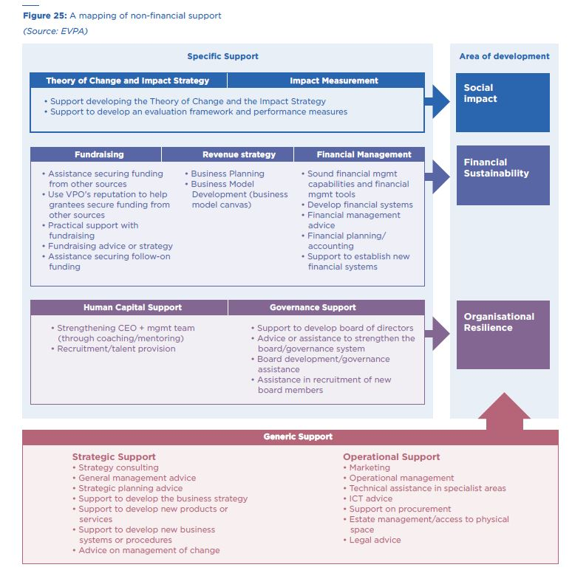
CHECK LIST OF NON FINANCIAL SUPPORT PROVIDED
Notes:
EVPA
A mapping of different kind of NFS provided

Slide 10
A THIRD LEVELS OF IMPACT FOR THE FUNDER: CONTRIBUTION TO THE IMPACT ECOSYSTEM
Developing a thriving local impact ecosystem. In countries where the impact market is less mature, investors for impact give importance to building an ecosystem to strengthen both the supply and the demand side.
Integrating a system change lens. Investors for impact that incorporate a system change lens go beyond measuring the impact of concrete investments and strive for an understanding of what the changes and challenges happening in the systems where they operate are.
Notes:
1) This is especially important for organisations pioneering investing for impact in their country or region. Some examples of fostering the local ecosystem include (i) engaging with more traditional investors and educating them on embedding impact considerations e.g. through co-investments; (ii) raising awareness about investing for impact within mainstream impact investing e.g. by organising webinars or appearing in media; (iii) positioning the impact sector e.g. by forming alliances with peers and/or advocating for it with policy makers; and (iv) engaging with the public sector, e.g. by developing hybrid financial mechanisms.
2) Incorporating a system change lens entails understanding the root causes of a societal problem, embracing complexity, non-linear thinking and interconnections. This approach requires bringing together relevant partners to challenge the way the societal issue is tackled and defining where to intervene.

Slide 11
Keeping in mind these key aspects:
Creating a theory of change – at investor and SPO levels
Stakeholders involvement – stakeholder ability to shape what is measured (outcomes)
Identification of outcome indicators - at investor and SPO levels (direct impact) and final beneficiaries level (indirect impact)
  Financial and non-financial support – how to provide effectively
  Aggregation of impact at portfolio level
Impact management – how is evidence used to increase impacts?

Slide 12
Evpa knowledge centre reports & tools
evpa.eu.com/knowledge-centre

Slide 13
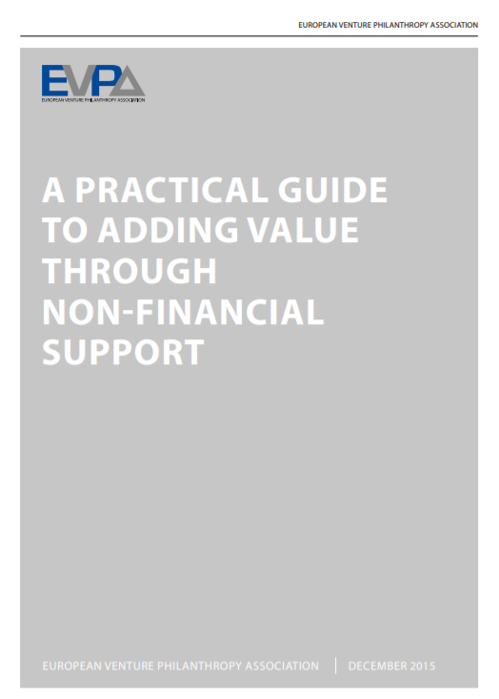



evpa.eu.com/knowledge-centre
KEY PUBLICATIONS ON SOCIAL INVESTMENT AND EVPA’S 3 CORE PRACTICES

Slide 14

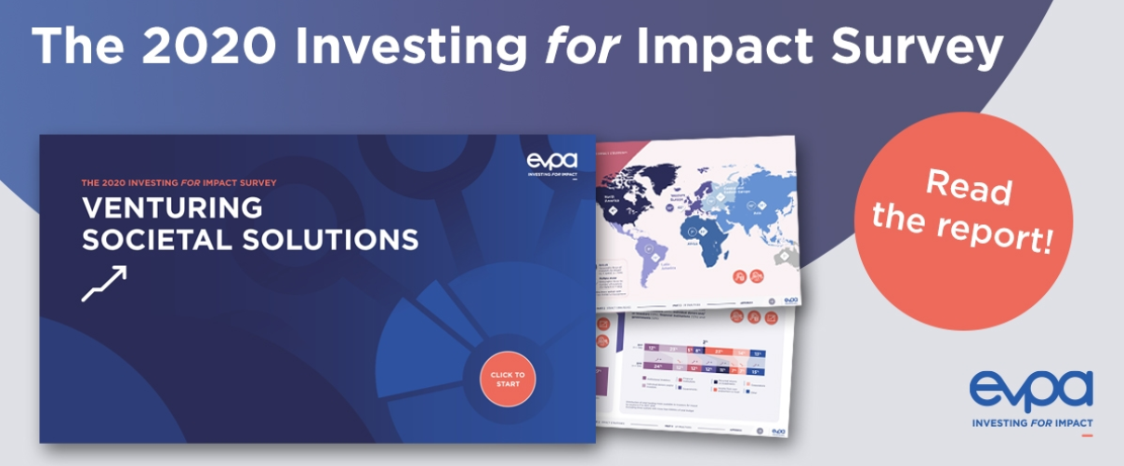
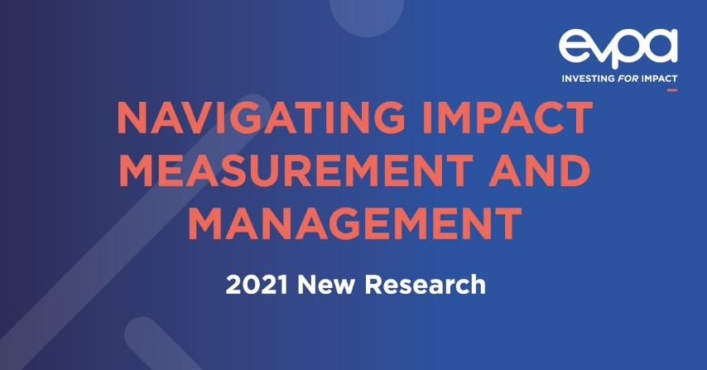
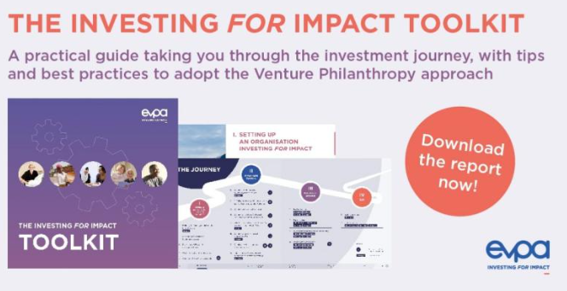
Discover our research & tools from our Knowledge Centre: evpa.eu.com/knowledge-centre
Industry Survey
Through our Industry Surveys, we are the main repository of data of investors for impact since 2010
Success Stories
Discover stories and videos to see how investors for impact, through the VP approach, support SPOs in achieving and scaling their social impact
IMM Research & Interactive Dashboards
EVPA developed three dynamic dashboards showing how practitioners are measuring and, more importantly, managing their own impact and the one of their investments.
Investing for Impact
Toolkit
The Toolkit assists newcomers to investing for impact by outlining strategies & best practices for adopting the venture philanthropy approach.

Slide 15
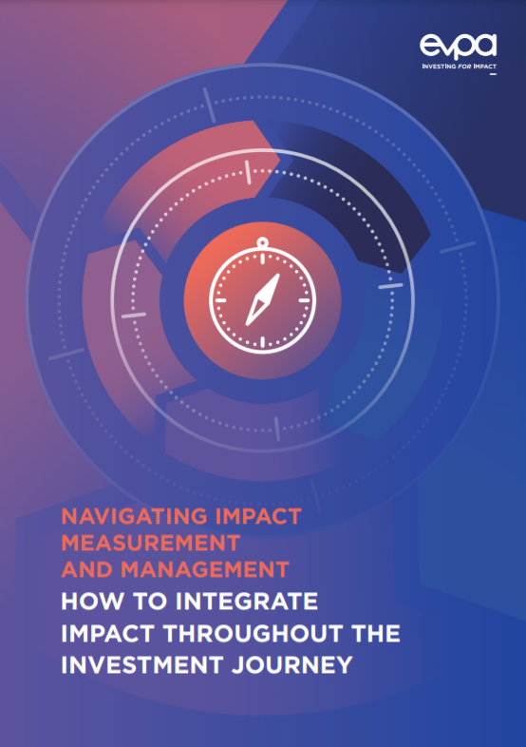
REPORT: HOW TO INTEGRATE IMPACT THROUGHOUT THE INVESTMENT JOURNEY
This report summarises the main elements to be taken into account to measure and manage impact throughout the investment strategy and the investment process, linking each phase to the relevant steps of the EVPA five-step framework.
To clarify how the EVPA five-step process and other IMM initiatives are linked and complement each other, this publication also refers to different principles or standards throughout the investment journey, such as the Dimensions of impact of the Impact Management Project, the Operating Principles of Impact Management, the Principles of Social Value and the SDG Impact Standards.
https://evpa.eu.com/knowledge-centre/publications/navigating-impact-measurement-and-management

Slide 16

EVPA
RUE ROYALE 94
B-1000 BRUSSELS
T +32 2 513 21 31
info@evpa.eu.com
EVPAupdates
evpa
@_EVPA_
www.evpa.eu.com

