Slide 1



In-Depth Social Impact Measurement & Management Online Training
Live Session, Module 3, 30 November 2021, 09:00-12:00 CET
Notes:
TIMING: 10.00-10.20

Slide 2
Managing impact reflections. Global trends on the impact measurement and management landscape

Slide 3




ADAM RICHARDS
DIRECTOR OF IMPACT, SVI
SOCIAL VALUE INTL
SARA SEGANTI
SENIOR TRAINING MANAGER
EVPA
FLORIAN TUDER
TRAINING ACADEMY COORDINATOR
EVPA
ANDREA RESTA
TRAINING ACADEMY INTERN
EVPA

Slide 4
Module 3 | Global trends on the impact measurement and management landscape
E-learning phase On Zoom: Module 3 Live Session 30 November 2021 9-12am CET Speakers and facilitators: Priscilla Boiardi, OECD Adam Richards, Social Value Intl. Sara Seganti, EVPA Florian Tuder, EVPA | Preparation for the live session and assessment of comprehension Valuation and impact (Step 4 of the EVPA’s five-step framework to measure impact) Monitoring & Reporting (Step 5 of the EVPA’s five-step framework to measure impact) International development of IMM practice, Priscilla Boiardi Conclusions and Q&A

Slide 5
Quiz Time
Let‘s see if we are ready for the day!
Notes:
FT to launch Zoom polls

Slide 6
QUIZ TIME
Hover To The Top Of Your Screen > Select: „View Options“ > Select: „Annotation“ > Select: „Stamp“ > Stamp!
1/5: In IMM, value is subjective for different stakeholders but can be systematically measured by numbers (incl. monetisation). Why can this be a helpful approach?
  To have a better financial perspective about stakeholders
  To better compare different changes experienced by the same stakeholder
  To monitor the risk of negative outcomes for stakeholders

Slide 7
QUIZ TIME
Hover To The Top Of Your Screen > Select: „View Options“ > Select: „Annotation“ > Select: „Stamp“ > Stamp!
1/5: In IMM, value is subjective for different stakeholders but can be systematically measured by numbers (incl. monetisation). Why can this be a helpful approach?
  To have a better financial perspective about stakeholders
  To better compare different changes experienced by the same stakeholder
  To monitor the risk of negative outcomes for stakeholders

Slide 8
QUIZ TIME
Hover To The Top Of Your Screen > Select: „View Options“ > Select: „Annotation“ > Select: „Stamp“ > Stamp!
2/5: What is one advantage of monetisation:
  Creating revenues from a project
  Bridging the accountability gap between decision-makers and those who these decision target.
  Putting a market price on things we usually do not monetise (1 unit of wellbeing = 50 Euros)

Slide 9
QUIZ TIME
Hover To The Top Of Your Screen > Select: „View Options“ > Select: „Annotation“ > Select: „Stamp“ > Stamp!
2/5: What is one advantage of monetisation:
  Creating revenues from a project
  Bridging the accountability gap between decision-makers and those who these decision target.
  Putting a market price on things we usually do not monetise (1 unit of wellbeing = 50 Euros)

Slide 10
QUIZ TIME
Hover To The Top Of Your Screen > Select: „View Options“ > Select: „Annotation“ > Select: „Stamp“ > Stamp!
3/5: A key question – besides “So what?” – you should constantly ask yourself during the valuation process is:
  Enough precision for the decision
  Valuation before information
  Measurement before management

Slide 11
QUIZ TIME
Hover To The Top Of Your Screen > Select: „View Options“ > Select: „Annotation“ > Select: „Stamp“ > Stamp!
3/5: A key question – besides “So what?” – you should constantly ask yourself during the valuation process is:
  Enough precision for the decision
  Valuation before information
  Measurement before management

Slide 12
QUIZ TIME
Hover To The Top Of Your Screen > Select: „View Options“ > Select: „Annotation“ > Select: „Stamp“ > Stamp!
4/5: What is one of the most dangerous aspects of monetisation (and of IMM in general), using big and impressive numbers?
  Risk of making financial losses
  To produce too many outcomes
  Impact Washing

Slide 13
QUIZ TIME
Hover To The Top Of Your Screen > Select: „View Options“ > Select: „Annotation“ > Select: „Stamp“ > Stamp!
4/5: What is one of the most dangerous aspects of monetisation (and of IMM in general), using big and impressive numbers?
  Risk of making financial losses
  To produce too many outcomes
  Impact Washing

Slide 14
QUIZ TIME
Hover To The Top Of Your Screen > Select: „View Options“ > Select: „Annotation“ > Select: „Stamp“ > Stamp!
5/5: What are some ways to calculate the counterfactual (deadweight):
  Consultation – ask stakeholders
  Statistical testing, i.e. regression analysis
  Use emotional-sociological AI software
  Comparison with national/regional data
  Comparison with a control group

Slide 15
QUIZ TIME
Hover To The Top Of Your Screen > Select: „View Options“ > Select: „Annotation“ > Select: „Stamp“ > Stamp!
5/5: What are some ways to calculate the counterfactual (deadweight):
  Consultation – ask stakeholders
  Statistical testing, i.e. regression analysis
  Use emotional-sociological AI software
  Comparison with national/regional data
  Comparison with a control group

Slide 16
RECAP Step 4: verify and value impact at the spo level
HOW MUCH OF THE CHANGES DID WE CAUSE?

Slide 17
COUNTERFACTUAL: HOW CAN YOU GET INFORMATION
Valuation allows us to compare different changes using a consistent unit of measurement
Understanding the relative importance is the key – which changes are more important, and by how much?
Value lies in the eyes of the stakeholder
Can be monetised, but does not have to be

Slide 18

VALUATION METHODS
Weighting – relative importance of changes – for example, asking stakeholders to rate the changes on a scale of 1 to 10
Replace weights with financial proxies – this is still relative importance of changes

Slide 19
HOW MUCH DID WE CAUSE?
Why would we be interested in understanding impact i.e. how much of the changes have been created by our SPO?

Slide 20
COUNTERFACTUAL: HOW CAN YOU GET INFORMATION
What amount of changes have happened anyway (counterfactual/deadweight)?
Thinking about systemic or non-identified influences that would affect your intervention group as well as a control group
Insights – could we re-allocate resources to where they are most needed?
Different options to calculate – depending on rigour required
Stakeholder feedback
Secondary data benchmarking
Statistical analysis
Quasi-experimental
Randomised Control Trials

Slide 21
COUNTERFACTUAL: HOW CAN YOU GET INFORMATION
Who else contributed to the changes (attribution)?
Those other individuals or groups that contribute specifically to your intervention group, but not a control group
Insights – what other stakeholders could we work with to increase value?
Less rigorous options to calculate
Stakeholder (those affected) feedback
Consultation with other stakeholders
Comparison of value contributed by others (using this as the attribution figure)

Slide 22
Quiz Time
Let‘s see if we are ready for Step 5!
Notes:
FT to launch Zoom polls

Slide 23
QUIZ TIME
Hover To The Top Of Your Screen > Select: „View Options“ > Select: „Annotation“ > Select: „Stamp“ > Stamp!
1/3: When looking at monitoring and reporting, materiality is a key concept. Broken down, materiality refers to:
  Systematising „gut feeling“ into an excel template provided by Social Value UK
  A set of professional judgments
  A 5-steps framework by EVPA that helps to assess materiality

Slide 24
QUIZ TIME
Hover To The Top Of Your Screen > Select: „View Options“ > Select: „Annotation“ > Select: „Stamp“ > Stamp!
1/3: When looking at monitoring and reporting, materiality is a key concept. Broken down, materiality refers to:
  Systematising „gut feeling“ into an excel template provided by Social Value UK
  A set of professional judgments
  A 5-steps framework by EVPA that helps to assess materiality

Slide 25
QUIZ TIME
Hover To The Top Of Your Screen > Select: „View Options“ > Select: „Annotation“ > Select: „Stamp“ > Stamp!
2/3: According to the EVPA 5-Steps-Framework, an investor for impact or business support organisation should collect and analyse data on:
  Specific indicators that measure its progress towards reaching its overarching social objectives
  Time invested and/or € provided in non-financial support to its investees
  The ratio of positive outcomes vs. outputs and collecting them in an Excel template available on the EVPA website
  The investee SPOs, according to the objectives and indicators previously defined

Slide 26
QUIZ TIME
Hover To The Top Of Your Screen > Select: „View Options“ > Select: „Annotation“ > Select: „Stamp“ > Stamp!
2/3: According to the EVPA 5-Steps-Framework, an investor for impact or business support organisation should collect and analyse data on:
  Specific indicators that measure its progress towards reaching its overarching social objectives
  Time invested and/or € provided in non-financial support to its investees
  The ratio of positive outcomes vs. outputs and collecting them in an Excel template available on the EVPA website
  The investee SPOs, according to the objectives and indicators previously defined

Slide 27
QUIZ TIME
Hover To The Top Of Your Screen > Select: „View Options“ > Select: „Annotation“ > Select: „Stamp“ > Stamp!
3/3: The cost to support and maintain an SPO’s impact monitoring system (including personnel time and costs) should be part of the SPO’s budget and hence part of the […] in order to decide how costs should and/or could be split.
  …Statistical assessment of comparable regional data
  …a collaboration agreement developed by the staff of the SPO
  …Deal structuring with the investor/grant-maker

Slide 28
QUIZ TIME
Hover To The Top Of Your Screen > Select: „View Options“ > Select: „Annotation“ > Select: „Stamp“ > Stamp!
3/3: The cost to support and maintain an SPO’s impact monitoring system (including personnel time and costs) should be part of the SPO’s budget and hence part of the […] in order to decide how costs should and/or could be split.
  …Statistical assessment of comparable regional data
  …a collaboration agreement developed by the staff of the SPO
  …Deal structuring with the investor/grant-maker

Slide 29
RECAP Step 5: monitoring & reporting at spo level
Notes:
This slide will need to reflect svuk principles as well

Slide 30
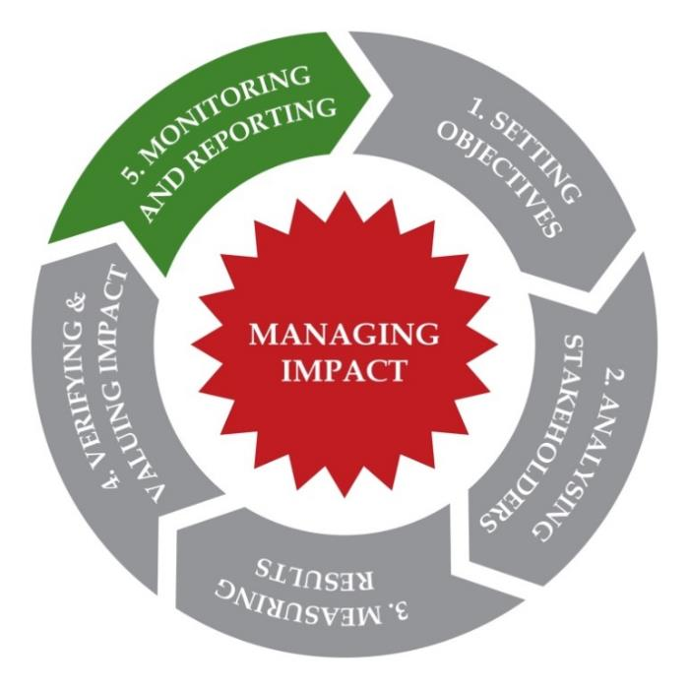
IM PROCESS/ STEP 5: MONITORING & REPORTING
Monitoring: track progress against (deviation from) indicators & objectives
Reporting: transforming data into presentable formats, relevant for key stakeholders (may need >1 report)
Notes:
Monitoring: tracking progress against (deviation from) indicators & objectives → https://kopernik.info/
Reporting: transforming data into presentable formats, relevant for key stakeholders (may need >1 report) to make them:
appropriate to the audience
transparent and USEFUL
Iterative process: what is monitoring to one stakeholder is reporting to another
VP/SI: systemise data it tracks (overall, per SPO, non-financial support provided), analyse to identify problems & implement corrective actions
SPO: evaluate outcomes & impacts achieved, practical lessons learned, actions needed to increase impact
Tools and resources available: PULSE (numeric metric data collection and reporting tool), Social Reporting Standard (guidelines & framework), Global Reporting Initiative (principles of report quality)

Slide 31
KEY ISSUES IN REPORTING TO MAXIMISE
Proportionality
Getting enough data to set a budget
Answering all impact question
Frequent data collection
Involve stakeholders
Alignment with the audience and purpose
Notes:
You may develop your own excel file
Choose your tools?
How frequently?
are indicators consistent?

Slide 32
MATERIAL IMPACTS
Materiality is about making judgements
  Need to establish internal judgements on appropriate thresholds
Material changes matter to those affected
Material changes need to be managed
Establishing the boundaries to your impact management framework
  What impacts are included and what are excluded from analysis and management
Notes:
You may develop your own excel file
Choose your tools?
How frequently?
are indicators consistent?

Slide 33

EVPA
RUE ROYALE 94
B-1000 BRUSSELS
T +32 2 513 21 31
info@evpa.eu.com
EVPAupdates
evpa
@_EVPA_
www.evpa.eu.com

