Slide 1



In-Depth Social Impact Measurement & Management Online Training
Live Session, Module 2, 25 November 2021, 09:00-12:00 CET

Slide 2
How to set-up an impact measurement and management system at the social purpose organisation (SPO) level – Defining outcome chains, indicators, targets, thresholds

Slide 3
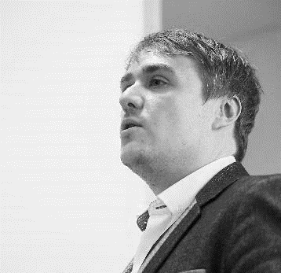



Our Speakers & Facilitators Today
ADAM RICHARDS
DIRECTOR OF IMPACT, SVI
SOCIAL VALUE INTL
SARA SEGANTI
SENIOR TRAINING MANAGER
EVPA
FLORIAN TUDER
TRAINING ACADEMY COORDINATOR
EVPA
ANDREA RESTA
TRAINING ACADEMY INTERN
EVPA

Slide 4
Module 2 | How to set-up an impact measurement and management system at the social purpose organisation (SPO) level – Defining outcome chains, indicators, targets, thresholds
E-learning phase | Preparation for the live session and assessment of comprehension
On Zoom: Module 2 Live Session 25 November 2021 9-12am CET Speakers and facilitators: Adam Richards, Social Value Intl. Sara Seganti, EVPA Florian Tuder, EVPA | Managing consequences at the SPO level Recap and Q&A Reflection on Theory of Change and outcome chains Defining outcome chains Defining indicator targets & thresholds (Step 3 of the EVPA’s five-step framework to measure impact)

Slide 5
Recap
Adam Richards & Florian Tuder

Slide 6
Quiz Time
Let‘s see if we are ready for the day!
Notes:
FT to launch Zoom polls

Slide 7
QUIZ TIME
Hover To The Top Of Your Screen > Select: „View Options“ > Select: „Annotation“ > Select: „Stamp“ > Stamp!
(1/5) What does the following statement describe: Kapow trained 50 ex-offenders over the course of one year?
  Output
  Outcome
  Activity

Slide 8
QUIZ TIME
Hover To The Top Of Your Screen > Select: „View Options“ > Select: „Annotation“ > Select: „Stamp“ > Stamp!
(1/5) What does the following statement describe: Kapow trained 50 ex-offenders over the course of one year?
  Output
  Outcome
  Activity

Slide 9
QUIZ TIME
Hover To The Top Of Your Screen > Select: „View Options“ > Select: „Annotation“ > Select: „Stamp“ > Stamp!
(2/5) What does the following statement describe: Kapow improved the employability of 50% of its users?
  Output
  Outcome
  Activity

Slide 10
QUIZ TIME
Hover To The Top Of Your Screen > Select: „View Options“ > Select: „Annotation“ > Select: „Stamp“ > Stamp!
(2/5) What does the following statement describe: Kapow improved the employability of 50% of its users?
  Output
  Outcome
  Activity

Slide 11
Quiz time
Hover To The Top Of Your Screen > Select: „View Options“ > Select: „Annotation“ > Select: „Stamp“ > Stamp!
(3/5) What is Adam’s favourite question when it comes to outputs and outcomes?
  Why not?
  So what?
  What else?

Slide 12
Quiz time
Hover To The Top Of Your Screen > Select: „View Options“ > Select: „Annotation“ > Select: „Stamp“ > Stamp!
(3/5) What is Adam’s favourite question when it comes to outputs and outcomes?
  Why not?
  So what?
  What else?

Slide 13
Quiz time
Hover To The Top Of Your Screen > Select: „View Options“ > Select: „Annotation“ > Select: „Stamp“ > Stamp!
(4/5) Well-defined outcomes reflect the…
  …maximisation of financial returns
  …improvement of wellbeing of an end-user
  …the right choice of investors

Slide 14
Quiz time
Hover To The Top Of Your Screen > Select: „View Options“ > Select: „Annotation“ > Select: „Stamp“ > Stamp!
(4/5) Well-defined outcomes reflect the…
  …maximisation of financial returns
  …improvement of wellbeing of an end-user
  …the right choice of investors

Slide 15
Quiz time
Hover To The Top Of Your Screen > Select: „View Options“ > Select: „Annotation“ > Select: „Stamp“ > Stamp!
(5/5) What are the two key screens for materiality?
  Relevance and significance
  Specific and measurable
  Attainable and time-based

Slide 16
Quiz time
Hover To The Top Of Your Screen > Select: „View Options“ > Select: „Annotation“ > Select: „Stamp“ > Stamp!
(5/5) What are the two key screens for materiality?
  Relevance and significance
  Specific and measurable
  Attainable and time-based

Slide 17
Understand change
Adam Richards, Social Value Intl

Slide 18
GOOD OUTCOMES – WELL-DEFINED AND COMPLETE
Aspects of wellbeing that can be identified as well-defined outcomes
All outcomes – positive and negative
Outcomes that are reasonably sustainable, stakeholder informed and manageable (useful to improving impact)
Not so generalized as to be unhelpful for management (i.e. happiness, quality of life, wellbeing)
Opportunity to improve services based on segmentation

Slide 19
Step 3 measure impact at the spo level
How much change happened, and how to measure? (Defining indicators at the spo level)
How long do we need to measure the changes for?

Slide 20
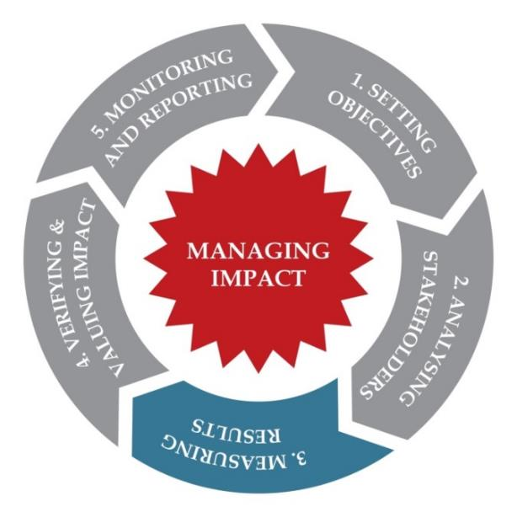
IMM PROCESS/ STEP 3: MEASURING RESULTS
For the SPO:
transforming its objectives in measurable results via outputs and outcomes indicators
Indicators: used to show progress towards or away from outputs and outcomes
Impact: often involves many professional judgments (drop off, displacement, counterfactual, attribution…)
Notes:
Develop a series of measures to make impact measurement concrete and quantifiable, building on the two previous steps.
Recommendation: calculate outcomes, acknowledge/adjust for factors increasing/decreasing impact (adjusted for the effects achieved by others (alternative attribution), for effects that would have happened anyway (deadweight), for negative consequences (displacement) and for effects declining over time (drop off)’
Outcomes: selected based on importance, materiality, usefulness, feasibility (of achievement not measurement)
Indicators: used to show progress towards or away from outputs and outcomes
Impact: often involves many theoretical assumptions (drop off, displacement, deadweight, attribution…)

Slide 21

IMM PROCESS/ SUGGESTED METHODS FOR STEP 3
Choose indicators:
  Identified by the stakeholder and/or designed specifically for the output/outcome
  Comparable with others - various libraries of standardised indicators (where necessary & appropriate) exist such as IRIS, or SDGs
  Objective and/or subjective
  Remembering, enough precision for the decisions
Set targets for the indicators
/!\ Do not jump ahead and identify indicators before having clearly understood the objectives and the Theory of Change
Source: EIIL and EVPA
Notes:
Develop a series of measures to make impact measurement concrete and quantifiable, building on the two previous steps.
How do you select a good indicator?
Aligned with purpose of organisation
Clearly defined, comparable with others - various libraries of standardised indicators exist such as IRIS, Global Value Exchange
- Aligned with the purpose of the organisation
- SMART (specific, measurable, achievable, relevant, time-bound)
- Clearly defined so that they can be reliably measured
More than one per outcome (2 or 3 better), but respecting proportionality – Adam – we would always advocate as few as is necessary. Only using as many as needed to inform the decision.

Slide 22

IMM PROCESS
appropriate indicators
How to transform a qualitative change to a quantitative amount of change?
We need indicators for all outputs and outcomes
Today, let’s just focus on our outcomes
What indicators could be used to measure:
  Depression?
  Having a job people are satisfied with?
Source: EIIL and EVPA

Slide 23
INCREASING RIGOUR: SUBJECTIVE SCALES
Binary: “Have you been stressed in the last 2 weeks?” Y/N
Scale: “On a scale of 1 to 5 how stressed have you been in the last 2 weeks?” (1 is lowest)
Validated/descriptive scale: “On a scale of strongly agree to strongly disagree, answer the statement; In the last 2 weeks I have been very stressed”
Questionnaire: “Using a series of questions (with validated scales)”

Slide 24

HOW LONG SHOULD WE MEASURE OUTCOMES?
DURATION: KAPOW EXAMPLE
For how long will you be accountable for the outcomes?

Slide 25
Outcome Duration
Does the outcome sustain without the intervention?
If so, how long does it last?
And for how long will you be accountable for it? (collect information to check it is still happening)
And how frequently do you need to measure?

Slide 26

EVPA
RUE ROYALE 94
B-1000 BRUSSELS
T +32 2 513 21 31
info@evpa.eu.com
EVPAupdates
evpa
@_EVPA_
www.evpa.eu.com

