Slide 1



In-Depth Social Impact Measurement & Management Online Training
Live Session, Module 1, 23 November 2021, 09:00-12:00 CET

Slide 2
How To Set-up An Impact Measurement And Management System At The Social Purpose Organisation (SPO) Level – From Setting Objectives To Analysing Stakeholders

Slide 3
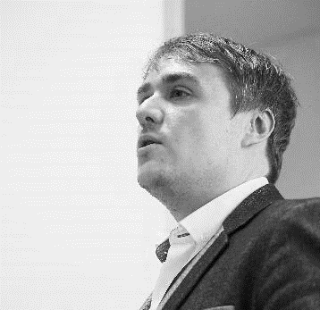

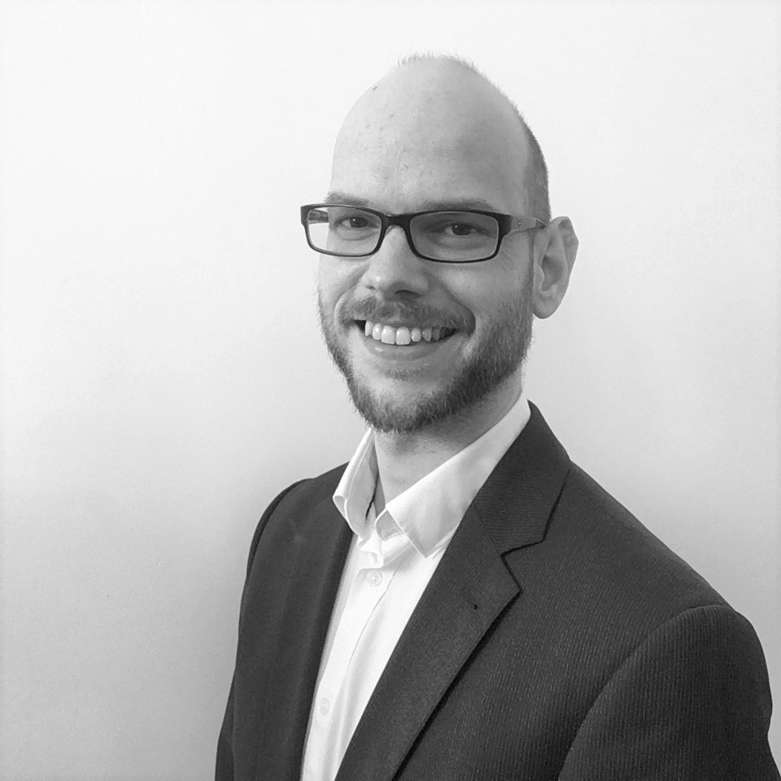

Our Speakers & Facilitators Today
ADAM RICHARDS
DIRECTOR OF IMPACT, SVI
SOCIAL VALUE INTL
SARA SEGANTI
SENIOR TRAINING MANAGER
EVPA
FLORIAN TUDER
TRAINING ACADEMY COORDINATOR
EVPA
ANDREA RESTA
TRAINING ACADEMY INTERN
EVPA

Slide 4
The Course Agenda
Florian Tuder, EVPA

Slide 5
Module 1 | How to set-up an impact measurement and management system at the social purpose organisation (SPO) level – from setting objectives to analysing stakeholders
E-Learning phase On Zoom: Module 1 Live Session 23 November 2021 9-12am CET Speakers and facilitators: Adam Richards, Social Value Intl. Sara Seganti, EVPA Florian Tuder, EVPA | Preparation for the live session and assessment of comprehension Setting up impact goals at the SPO level Introduction to the impact measurement and management space Impact questions Setting up objectives, audience and purpose, analyse stakeholders at the SPO level (Step 1 and 2 of the EVPA’s five-step framework to measure impact)
Notes:
Definition of SPO and VPO – just to be sure they know what it is

Slide 6
Module 2 | How to set-up an impact measurement and management system at the social purpose organisation (SPO) level – from defining outcome chains and indicators to valuation and reporting.
E-learning phase | Preparation for the live session and assessment of comprehension
On Zoom: Module 2 Live Session 25 November 2021 9-12am CET Speakers and facilitators: Adam Richards, Social Value Intl. Sara Seganti, EVPA Florian Tuder, EVPA | Managing consequences at the SPO level Recap and Q&A Reflection on Theory of Change and outcome chains Defining outcome chains Defining indicator targets & thresholds (Step 3 of the EVPA’s five-step framework to measure impact)

Slide 7
Module 3 | Global trends on the impact measurement and management landscape
E-learning phase On Zoom: Module 3 Live Session 30 November 2021 9-12am CET Speakers and facilitators: Priscilla Boiardi, OECD Adam Richards, Social Value Intl. Sara Seganti, EVPA Florian Tuder, EVPA | Preparation for the live session and assessment of comprehension Valuation and impact (Step 4 of the EVPA’s five-step framework to measure impact) Monitoring & Reporting (Step 5 of the EVPA’s five-step framework to measure impact) International development of IMM practice, Priscilla Boiardi Conclusions and Q&A

Slide 8
Module 4 | The practical experience of two EVPA members: best practices in IMM from the funders’ perspective
E-learning phase On Zoom: Module 4 Live Session 2 December 2021 09-12am CET Speakers and facilitators: Sofia Shaginyan, Navstrechu Peremenam Bennet Barth & Maya Volwahsen, Respond Accelerator, BMW Foundation Adam Richards, Social Value UK Sara Seganti, EVPA Florian Tuder, EVPA | Preparation for the live session and assessment of comprehension Reflections on measuring and managing impact from the funders’ perspective Examples from practice – two investors for impact will showcase how to measure and manage impact. Sofia Shaginyan, Navstrechu Peremenam Bennet Barth & Maya Volwahsen, Respond Accelerator - BMW Foundation Conclusions, Q&A, and wrap-up

Slide 9

Have a practical understanding of impact measurement frameworks and their implementation
Understand what it means to set goals at SPO level and to monitor them
Reflect on consequences at the SPO level: who changes, how they change and how can measure this change?
Understand the importance of managing impact

Slide 10
Have a practical understanding of what is it to set up an impact measurement system at the BSO’s level and to manage it at the portfolio level
Gain confidence to be able to use data on social impact to make changes in activities to increase social value for people

Slide 11
What do we mean by value, impact and management?
Adam Richards, Social Value International

Slide 12
What do we mean by...
IMPACT
The amount of change in people’s lives that is a result of the activities
VALUE
Relative importance of different changes
MANAGE
Do things to increase positive changes & reduce negative changes
MAXIMISE
Make changes in an attempt to create as much value as possible

Slide 13
Why do we do it?
M
measure
find out how much of a change has occurred
M
manage
do things to increase positive changes and reduce negative changes
M
maximise
making as much of a difference as possible with the resources available?

Slide 14
Two screens for Materiality
Relevant (qualitative judgement) to at least one of the following: your policies, your stakeholders, work of peers, societal norms, short term financial impacts. 1st screen– include or not?
Significant (quantitative judgement) means that the real or potential impact of the issue (both positive and negative) has passed a threshold that means it influences decisions and actions – 2nd screen- keep in or not?
An impact is material if it matters to the people affected
This will therefore affect the decision we take

Slide 15
Audience and purpose
Different audiences have different purposes (decisions to make)
They need evidence presented differently - with varying degrees of granularity to aggregation
Funders/investors and the public need more aggregation
Management/operations need detail (granularity)
They also need different levels of verification of the results to have the confidence to use them
Funders/investors and the public need external verification
Management/operations need scrutiny from those whose lives are affected

Slide 16
The Principles of Social Value
Principles that you can apply to answer those questions applied in a framework, that will help you manage, plan and make decisions to increase the value created for your stakeholders by your activities
Adam Richards, Social Value International

Slide 17
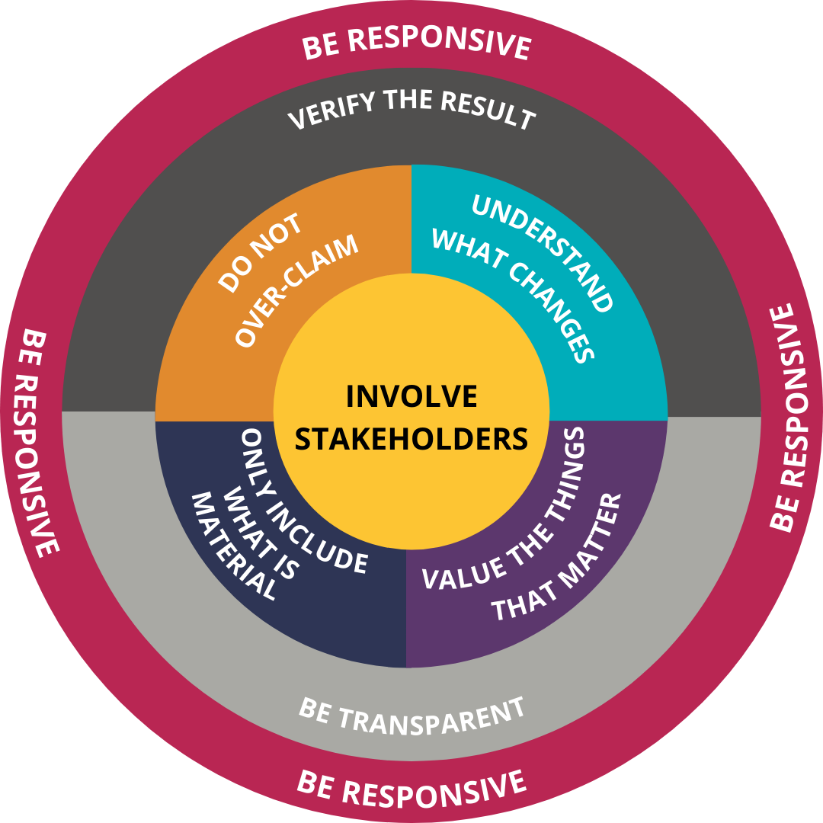

Principles of Social Value

Slide 18
Five steps process and practice
Spo level
Adam Richards, Social Value International

Slide 19
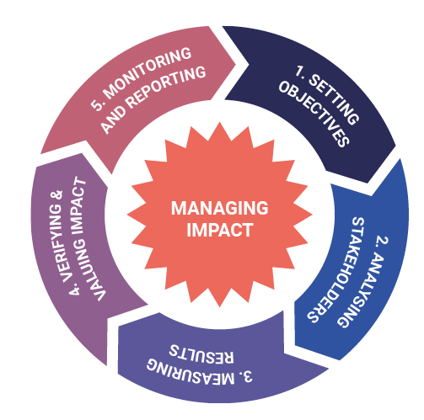
THE FIVE-STEP IMPACT MEASUREMENT PROCESS
Impact Measurement as a:
General framework
(process approach)
Learning Process
Management Tool
Notes:
Impact Measurement as a:
General framework (process approach)
Learning Process
Management Tool
The Practical Guide to Measuring & Managing Impact proposes 5 steps of impact measurement:
Step 1 - Set Objectives: define the problem & proposed solution, set “SMART” objectives
Step 2 – Analyse Stakeholders: Identify stakeholders (funders, members, other networks etc.) & engage with them to understand expectations
Step 3 – Measure Results: outputs, outcomes & impact and set indicators
Step 4 – Verify & Value Impact: verify through desk research, competitive analysis & interviews
Step 5 – Monitor & Report: data will be collected in line with indicators set in Step 3 (excel, salesforce, responsible to be appointed). Once analysed consider quarterly management reports and annual external reports
IMI conceived to address concerns raised by EVPA members about guidance on how to work with the maze of existing methodologies, databases, tools & metrics
It is neutral in terms of methodologies, databases, tools and metrics and does not “reinvent the wheel”
It is grounded in practice as it is the result of a multi-stakeholder initiative
Hands-on manual on impact measurement
Tool to assist social investors in their daily activities
Increase transparency and accountability of VP industry
Neutral in terms of methodologies, databases, tools and metrics
Road map on how to actually implement an impact measurement system for a VPOs (investors) and their SPOs (investees)
Focus: providing a toolkit that can be adapted to the diverse outcomes of social enterprises’ activities and stakeholders rather than seeking the ‘holy grail’ of a single tool, in other words the one-size-fits-all approach

Slide 20
Step 1
Setting up objectives at SPO level

Slide 21
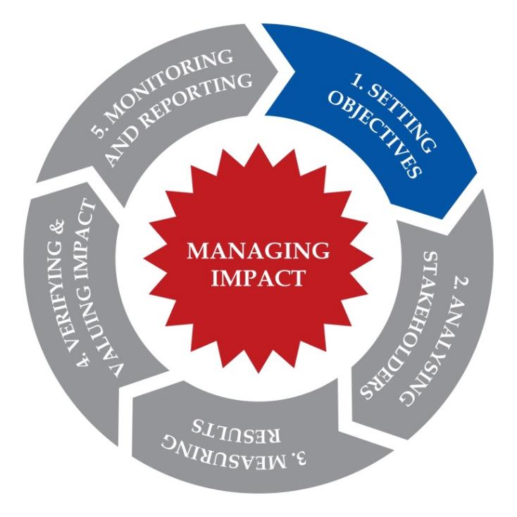
IMM PROCESS/ STEP1: SETTING OBJECTIVES
Set specific impact objectives: social problem → proposed solutions
More specific objectives means better preparation for impact measurement
Wide range of methods & tools available: all include elements of theory of change
Notes:
Wide range of methods & tools available: theory of change, logic model, parts of methodologies like SROI or balanced scorecard
A theory of change shows an organisation's path from needs to activities to outcomes to impact - following the impact value chain

Slide 22
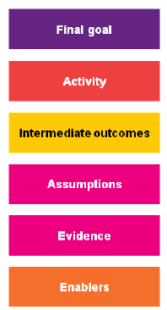
THEORY OF CHANGE/ THE PROCESS
Identify the beneficiaries you are working for, and set their needs, characteristics, and the impact goal you want to achieve
Work backwards to define the outcomes, i.e. the changes experienced by the beneficiaries that contribute to the achievement of the final goal. Support with evidence!
How will activities make this change happen?
What are the enablers?
Source: NPC
Notes:
IMPACT GOAL = the change you want to see in the final beneficiaries. Best to have just ONE!!!
FROM IMPACT GOAL TO OUTCOMES → ASSUMPTIONS!!!
YOU DO NOT MEASURE YET!!!
Enabler = Internal enablers: internal to the org, explain how you deliver your work (quality of services, relationships, attitude and values of staff)
External enablers: external environment, context in which you work, social, cultural and political factors, laws, regulations,… beyond the organisation’s control.
Evidence vs. assumptions → if evidence contradicts assumptions → rethink and revise.
ToC is the description of the sequence of events that are necessary to achieve the changes you want.
Using the ToC, the organisation is able to describe the needs to be addressed and the changes that we aim to and the activities that will produce such change.

Slide 23
THE THEORY OF CHANGE MODEL
Organisation’s Planned Work
Organisation’s Intended Results
Inputs
Activities
Outputs
Outcomes
Goal
Resources (capital, human, intellectual & social networks) invested in the activity | Concrete actions of the organisation | Tangible products from the activity | Changes, benefits, learnings, effects resulting from the activity | Main objectives of the activities
Financial resources Staff time Training providers and physical resources for training | Ex-offenders are trained in martial arts – working with qualified instructors twice a week for 6 months Practical employability training workshops Accredited training workshops for employment qualifications | Ex-offenders receive skills and work-related qualifications Each ex-offender gain martial arts qualifications | Increased knowledge Improved self-belief Ex-offenders more confident to look for work | Increased employment of ex-offenders
Notes:
Theory of Change
Maps the conditions that are needed to create the change you want to see
More nimble and less fixed than Logic Model
Allows you to reassess the conditions
Understand what works and what does not
Logic Model
Maps your work and results
Allows inclusion of indicators
Tracks work done and allows for pinpointing of bottlenecks
As such, the Logic Model tracks what the funder and the venture contributes and model the results of this
Check that what you want to track is included, as you may be able to track a lot that is not relevant for the impact you want to see.
Theory of Change and/or Logic Model
TOC is useful for early-stage ventures and to assess how the venture will affect change
Logic Model tracks what the funder and the venture contributes and model the results of this

Slide 24
Step 2 analyse stakeholders at spo level
Who experiences changes?
What outcomes are (OR ARE LIKELY) Experienced?
Adam Richards, Social Value International
Notes:
TIMING – 11.25-12.00

Slide 25
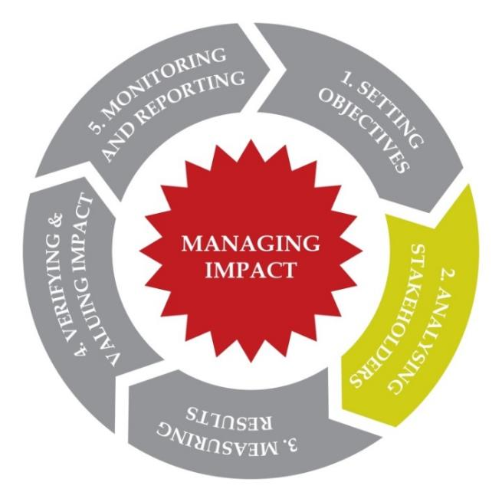
IMM PROCESS/ STEP 2: ANALYSING STAKEHOLDERS
Stakeholder: “Any party affecting and/or effected by the activities of the organisation”
Understand
  Expectations/interests
  contribution
  potential impact SPO’s work will have on them.
Two parts:
  Stakeholder identification
  Stakeholder engagement
Notes:
Who gains and who gives, what and how
Understand:
Level of engagement
Control over
Contribution to achieving the objectives
Stakeholder identification: mapping, selecting (materiality / relevance) & understanding expectations
Stakeholder engagement: opening communication & later (step 4) verifying if expectations have been met → Should be involved to some degree at each stage of IM --> follow guidance on PROPORTIONALITY!
Co-operation of main stakeholders critical in process
Begin by focusing on a small number of stakeholders but beware of missing large positive or negative issues

Slide 26
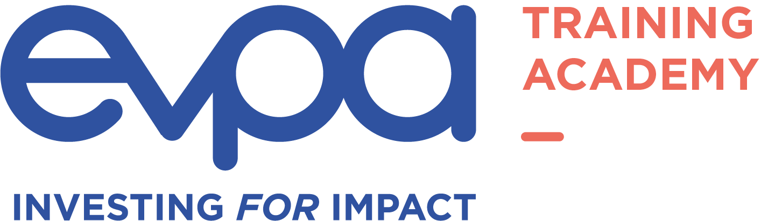
EVPA
RUE ROYALE 94
B-1000 BRUSSELS
T +32 2 513 21 31
info@evpa.eu.com
EVPAupdates
evpa
@_EVPA_
www.evpa.eu.com

